Slide 1
Introducing Extended Reach Solutions
ENDLESS INNOVATION
Notes:
Welcome to SYSTIMAX 2.0. Re-imagined, re-energized and ready to re-write the rules of enterprise network connectivity.
In this presentation, we’ll introduce you to a whole new SYSTIMAX brand. New solutions with plenty more on the drawing board for 2024 and beyond, new relevance as customers continue to evolve their enterprise networks, and new messaging that speaks volumes about the value, promise and potential of SYSTIMAX 2.0, CommScope’s flagship enterprise brand.

Slide 2

Meet SYSTIMAX® GigaREACH™ XL
250 m
10
Mbps
UP TO
90W
PoE
200 m
SYSTIMAX Assurance
100
Mbps
UP TO
EXTENDED PRODUCT WARRANTY
4K cameras
25
YEARS
150 m
APPLICATIONS
ASSURANCE
1
Gbps
UP TO
Reach 250 m
with full 90 W PoE
Telecom Room
Notes:
The result of this design is a unique solution that ensures warrantied support for 1-gigabit PoE up to 150 meters, 100-megabit PoE up to 200 meters, and 10-megabit PoE up to 250 meters. All while delivering a reliable 90 W of power regardless of the distance.
Note that we believe there isn’t a single other solution on the market that even claims to support 90 W PoE up to 250 m like we do.

Slide 3
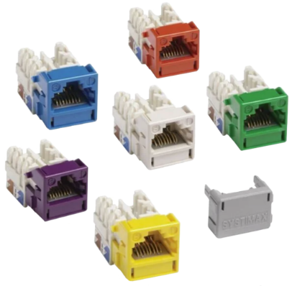
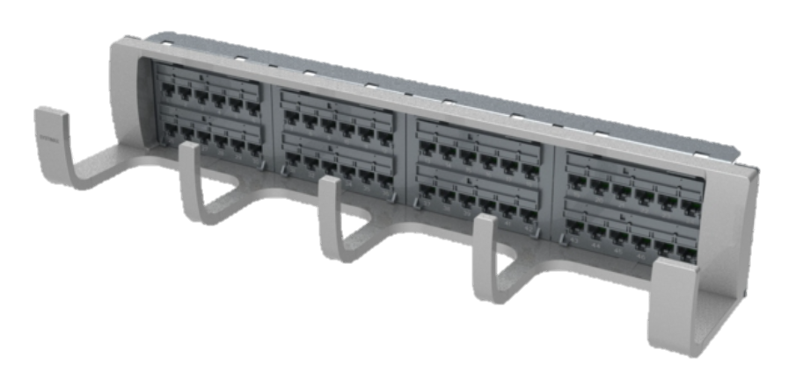
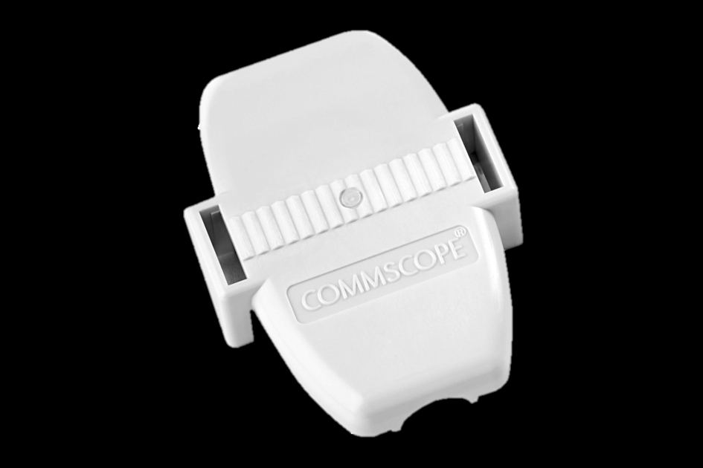
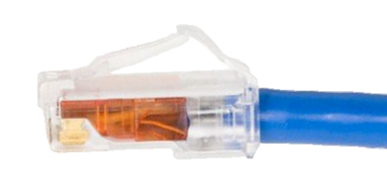
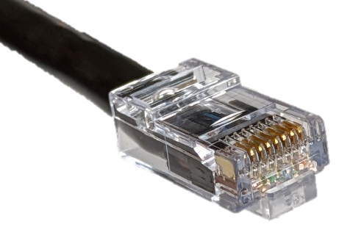
SYSTIMAX components supported in GigaREACH channels
All GigaSPEED XL jacks and panels
Ceiling connector assembly (CCA)
All GigaSPEED XL cords
New field-term plug
Detailed channel engineering rules for these and additional components under development, including elevated temperature derating factors
Notes:
Note that we are supporting all the existing components from our GigaSPEED XL solution in GigaREACH channels. We are also introducing a new field-term plug, specifically designed to ease direct termination of our new 21 AWG cable, which, as you can see, is about the same size as standard Cat 6 cable, although much lower loss—more on how we did that later in this presentation.

Slide 4
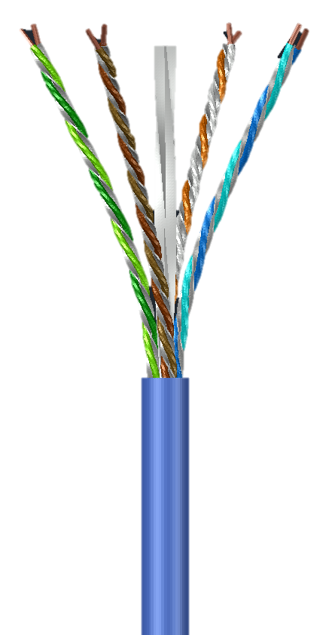
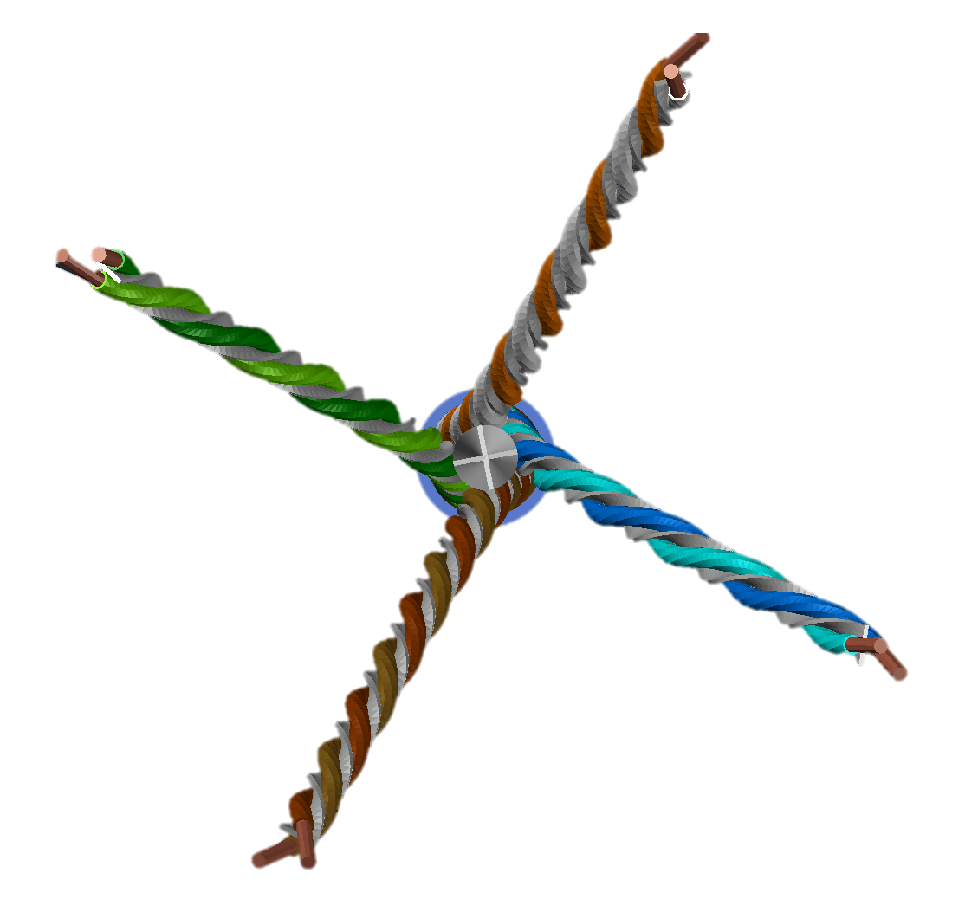
SYSTIMAX®
GigaREACH™ XL
THE WHAT.
WHAT’S UNDER THE HOOD?
21 AWG
Plenum, riser, LSZH or outdoor
Outside diameter: <6.6 mm (<0.26 inch)*
Connectivity: GigaSPEED XL
Certified to meet Cat 6 cable specs
Meets Cat 6 channel specs when used with GigaSPEED XL cords and connectors
* outdoor cable is approximately 1 mm larger diameter
Notes:
So, what’s under the hood?
All conductors are 21 AWG, which we believe is the largest in the industry.
The cables are available in plenum-rated, riser-rated or outdoor versions.
Its connectivity is compatible with SYSTIMAX GigaSPEED XL.
To top if off, GigaREACH XL is certified to meet Cat 6 cable specs and, when used with GigaSPEED XL cords and connectors, it also meets Cat 6 channel specs.

Slide 5

SYSTIMAX®
GigaREACH™ XL
THE BENEFITS.
EXTENDED REACH = EXPANDED OPTIONS
INCREASED SUSTAINABILITY
Reduced power energy losses → potential energy savings over multiple devices
Less need for telecom rooms →
lower environmental cost to build them
Fewer points of failure → fewer truck rolls, lower fuel use and reduced GHGe

Slide 6
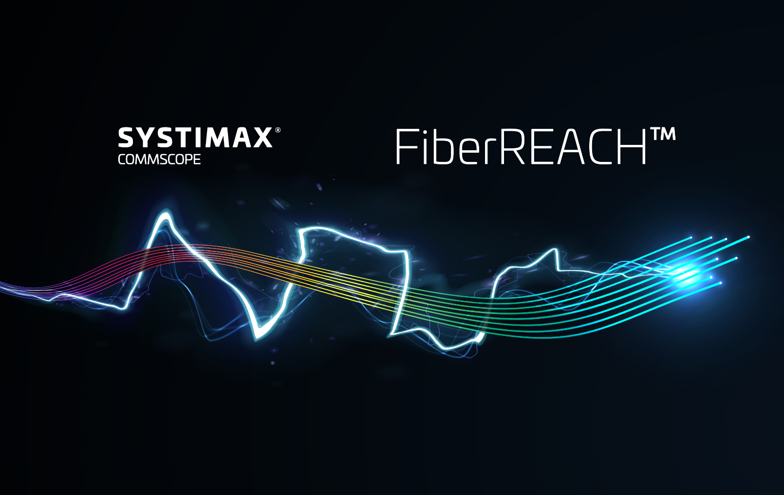
Extended distance solutions
Introducing FiberREACH™
Empower potential at the edge
Notes:
Empower potential at the edge.
The transformation of enterprise networks has been rapid and disruptive. No longer IT-specific, today’s network is expected to connect and power all operational systems and devices. Not a problem, assuming the device is less than 100 meters from the nearest telecom room.
But more mission-critical devices—security cameras, access control panels, wireless access points, etc.—are needed at the edge, with some exceeding the 100-meter limit set by the standards. That’s a problem. How can you support a device beyond the 100-meter threshold while ensuring the reliable performance of a standards-based connection? CommScope’s SYSTIMAX® FiberREACH™. Now you can extend your network’s reach without risk.

Slide 7




Accessing data
Securing data
Using
data
The need for…
DATA!
Cameras
Wi-Fi® APs
Small cells
IoT
Operational efficiency relies on security
User experience
Productivity
Notes:
We’ve got used to ubiquitous network data for a plethora of devices, but that data also needs to be secure in order to ensure proper operational efficiency, foster productivity and offer a good user experience.

Slide 8

Safe + reliable: PoE
Consistent availability
Standardized equipment
The need for…
POWER!
Notes:
All devices need power, that’s a truism, and the advantages of PoE is that it’s safe, reliable, proven and standardized.

Slide 9
IEEE PoE standardized equipment
Power source equipment (PSE)—transmission losses (cabling) = power delivered (PD)
Requesting and sourcing power per Type and Class of PoE device
Type 4 (802.3bt)
Type 3 (802.3bt)
Type 4 support FiberREACH
coming soon!
Type 1 (802.3af)
Type 2 (802.3at)
PSE
Power sourcing equipment
Class 1
4 W
Class 2
7 W
Class 3
15.4 W
Class 4
30 W
Class 5
45 W
Class 6
60 W
Class 7
75 W
Class 8
90 W
Class 1
3.84 W
Class 2
6.49 W
Class 3
13 W
Class 4
25.5 W
Class 5
40 W
Class 6
51 W
Class 7
62 W
Class 8
71.3 W
PD
Powered device
2-pair only (Type 1 & 2)
2-pair or 4-pair power (Type 3 & 4)
< 300 mA per conductor
< 480 mA per conductor
From 4 W in 2003 to 90 W in 2018
PoE: 44 – 57 V DC, typically 48 V DC – NEC Class 2
Notes:
Power over Ethernet has evolved—from initially sourcing up to 15 watts at the power source equipment (PSE) in 2003, increasing up to 30 watts in 2009, and up to 90W in 2018 at the PSE.
Note that Class 8 is sometimes referred to as 100 W PoE by some vendors since, under best case conditions, it can transmit nearly 100 W of power, but that is the best case—and thus fairly meaningless. What matters is what you can count on, which is 90 W less the amount consumed by transmission losses.

Slide 10
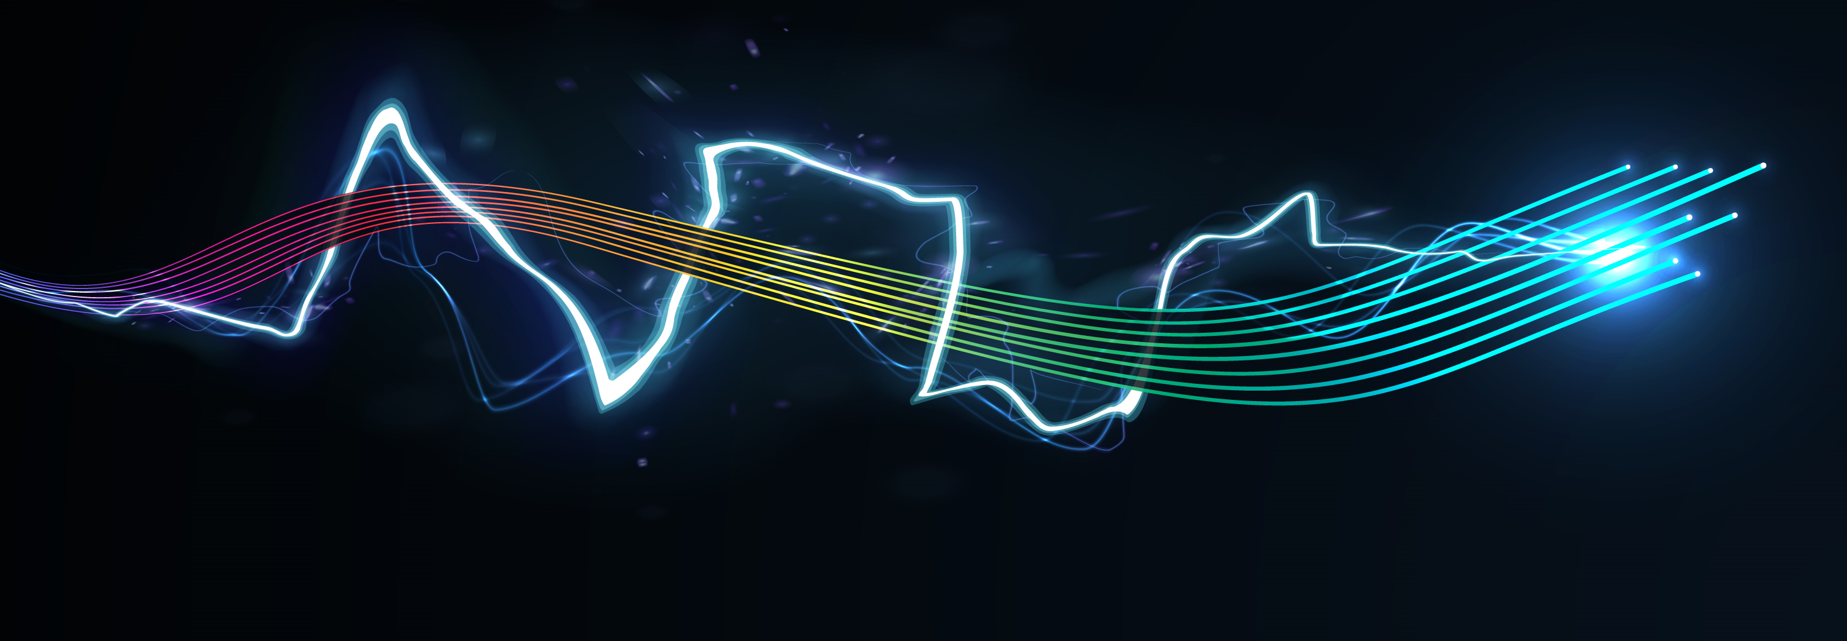
Empower potential at the edge
DATA + POWER + REACH
Notes:
Introducing FiberREACH, the solution that gives you Data and Power where you need it, with longer supported distances.

Slide 11
How far can we reach?
3,000 m
FiberREACH
(15 W)
100 m
Notes:
How long reach are we talking about?

Slide 12
Reach is power-dependent
FiberREACH distance examples
PoE 15 W
3,000 m
PoE+ 30 W
1,800 m
PoE+ 60 W
880 m
Notes:
Well, it depends on the PoE class we want to support, and there is also a bandwidth consideration.
We do have a FiberREACH calculator to help you out.

Slide 13
FiberREACH solution
Switches
FR
PoE
extender
Small
cell
Fiber panel
Splice enclosure
FR
PoE
extender
Wi-Fi AP
Security
camera
2 port
FR PoE
extender
FR power supply
Security
camera
UPS
Notes:
Let’s go first through the system description:
There are (3) primary components of a powered fiber architecture that make it unique from typical fiber or copper installs. Power sourcing equipment, hybrid power fiber cable and a DC power input at the device. The power sourcing equipment is typically a DC power supply- 48-60V Class 2/ low voltage. The power conductors of the hybrid cable terminate to the DC power supply, an intermediate cross connect can be introduced here if desired. Your endpoint device must have a DC power IN that is within the range of your DC power supplied voltage and current. Typical is 48 and 57 volts nominally and less than 100 watts to meet SELV Class 2.

Slide 14
FiberREACH solution: 3 steps
Switches
FR
PoE
Extender
Small
Cell
Fiber panel
FR
PoE
Extender
Wi-Fi AP
Security
Camera
1
2 port
FR PoE
Extender
FR power supply
Security
Camera
UPS
Notes:
First we have to choose the power supply:
Power Express power distribution chassis
1 rack unit height, 19-in or 26-in standard rack mount
Up to four (4) distribution modules per chassis, each with eight (8) dc output channels
Each output capable of providing 100-watt dc power Slimline Power System rectifier chassis

Slide 15
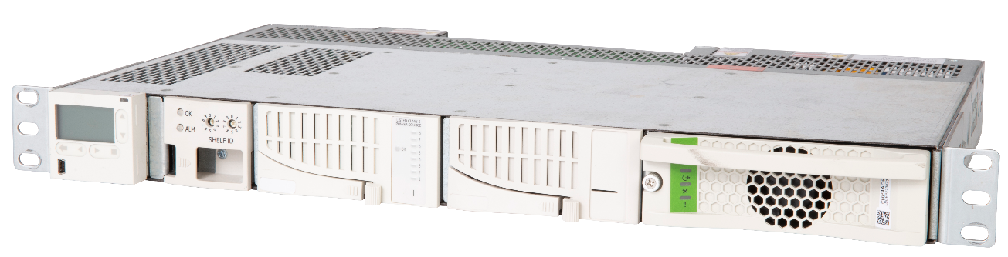
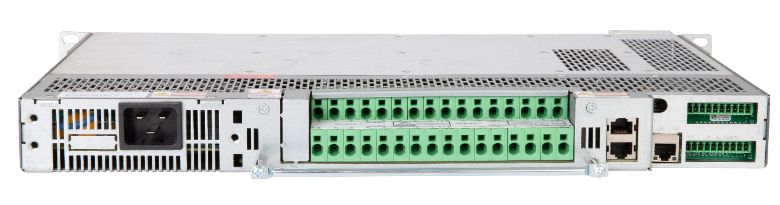
FiberREACH solution: 3 steps
Switches
FR
PoE
Extender
Small
Cell
Fiber panel
FR
PoE
Extender
Wi-Fi AP
MID/part number | Description
PFP-PX-S2 | Power Express Combo Shelf
PFP-PX-A1 | Power Express Alarm Card
PFP-PX-S1 | Power Express Distribution shelf with alarm module
PFP-PX-8M | Power Express Distribution module supports max. 8 Devices
PFP-SPS-S1 SPS | Rectifier Power Distribution Shelf
PFP-SPS-1600M | 1600 W SPS Power Rectifier module
PFP-SPS-C1 | SPS Rectifier Controller Display
Security
Camera
1
2 port
FR PoE
Extender
FR power supply
Security
Camera
UPS
Notes:
First we have to choose the power supply:
Power Express power distribution chassis
1 rack unit height, 19-in or 26-in standard rack mount
Up to four (4) distribution modules per chassis, each with eight (8) dc output channels
Each output capable of providing 100-watt dc power Slimline Power System rectifier chassis

Slide 16
FiberREACH solution: 3 steps
2
Switches
FR
PoE
Extender
Small
Cell
Fiber panel
FR
PoE
Extender
Wi-Fi AP
Security
Camera
1
2 port
FR PoE
Extender
FR power supply
Security
Camera
UPS
Notes:
Then the indoor (plenum, riser, LSZH) or outdoor hybrid cables (I/O version coming soon):
OM3 or OS2 (MM/SM)
From 2 to 16 fiber strands
12AWG or 16AWG for the copper PoE conductors

Slide 17
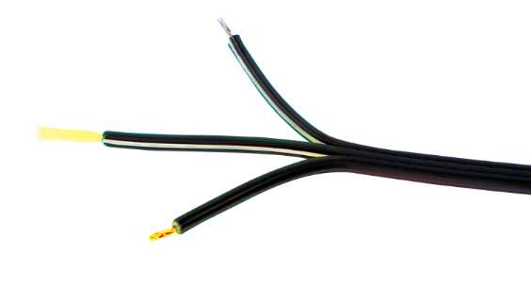
FiberREACH solution: 3 steps
2
Switches
FR
PoE
Extender
Small
Cell
MID/part number | Description of powered fiber cables
PFC-S02L12 | Indoor/Outdoor, OS2, 2 Fibers, 2 x 12 AWG Conductors
PFC-S02L16 | Indoor/Outdoor, OS2, 2 Fibers, 2 x 16 AWG Conductors
PFC-S02O12 | Outdoor, OS2, 2 Fibers, 2 x 12 AWG Conductors
PFC-S02O16 | Outdoor, OS2, 2 Fibers, 2 x 16 AWG Conductors
PFC-S04L12 | Indoor/Outdoor, OS2, 4 Fibers, 2 x 12 AWG Conductors
PFC-S04L16 | Indoor/Outdoor, OS2, 4 Fibers, 2 x 16 AWG Conductors
PFC-S04O12 | Outdoor, OS2, 4 Fibers, 2 x 12 AWG Conductors
PFC-S04O16 | Outdoor, OS2, 4 Fibers, 2 x 16 AWG Conductors
PFC-S12L12 | Indoor/Outdoor, OS2, 12 Fibers, 2 x 12 AWG Conductors
PFC-S12L16 | Indoor/Outdoor, OS2, 2 Fibers, 12 x 16 AWG Conductors
PFC-S12O12 | Outdoor, OS2, 12 Fibers, 2 x 12 AWG Conductors
PFC-S12O16 | Outdoor, OS2, 12 Fibers, 2 x 16 AWG Conductors
PFC-302L12 | Indoor/Outdoor, OM3, 2 Fibers, 2 x 12 AWG Conductors
PFC-302L16 | Indoor/Outdoor, OM3, 2 Fibers, 2 x 16 AWG Conductors
PFC-302O12 | Outdoor, OM3, 2 Fibers, 2 x 12 AWG Conductors
PFC-302O16 | Outdoor, OM3, 2 Fibers, 2 x 16 AWG Conductors
PFC-304L12 | Indoor/Outdoor, OM3, 4 Fibers, 2 x 12 AWG Conductors
PFC-304L16 | Indoor/Outdoor, OM3, 4 Fibers, 2 x 16 AWG Conductors
PFC-304O12 | Outdoor, OM3, 4 Fibers, 2 x 12 AWG Conductors
PFC-304O16 | Outdoor, OM3, 4 Fibers, 2 x 16 AWG Conductors
Fiber panel
FR
PoE
Extender
Wi-Fi AP
Security
Camera
1
2 port
FR PoE
Extender
FR power supply
Security
Camera
UPS
Notes:
Then the indoor (plenum, riser, LSZH), I/O or outdoor hybrid cables:
OM3 or OS2 (MM/SM)
From 2 to 16 fiber strands
12AWG or 16AWG for the copper PoE conductors
Indoor/Outdoor cable is suitable for dry environments only. Cable must not be installed in conduit, direct burial applications or below grade where cable is immersed or is continually in contact with water or moisture

Slide 18
FiberREACH solution: 3 steps
3
2
Switches
FR
PoE
extender
Small
Cell
Fiber panel
FR
PoE
extender
Wi-Fi AP
Security
Camera
1
2 port
FR PoE
extender
FR power supply
Security
Camera
UPS
Notes:
And last the PoE extenders:
dc/dc conversion electronics
Simplifies electrical engineering calculations by converting the received voltage to the correct dc voltage level for PoE output (48 VDC)
SELV and NEC Class 2 compliant
IP68 sealing—Enclosures are designed for outdoor installations with protection from moisture and the environment
Houses electronics, power termination, fiber management, and cable termination
Unobtrusive installation
60W 2-port variant enables 2 PoE or PoE+ devices to be connected via one hybrid cable

Slide 19
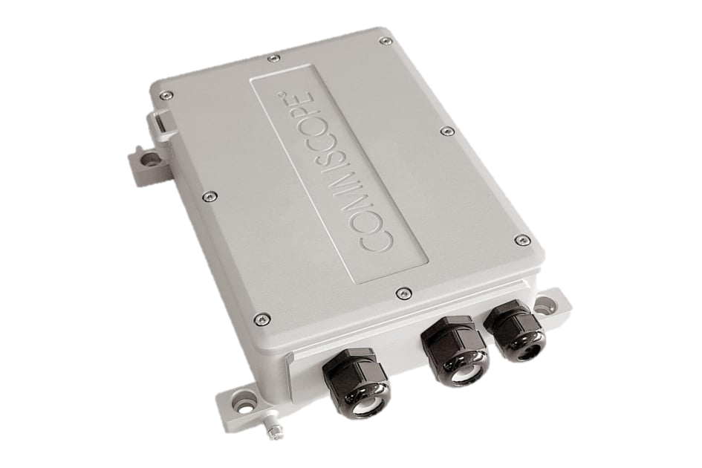
FiberREACH solution: 3 steps
3
2
Switches
FR
PoE
Extender
Small
Cell
Fiber panel
FR
PoE
Extender
Wi-Fi AP
MID/part number | Description
PFU-P-C-O-060-02 | 60 W, 2 Port PoE Extender
PFC-P-C-O-060-1 | 60 W total, 1 port PoE Extender
PFU-P-C-O-090-02 | 2 port PoE Extender 90 W total
Security
Camera
1
2 port
FR PoE
Extender
FR power supply
Security
Camera
UPS
Notes:
And last the PoE extenders:
dc/dc conversion electronics
Simplifies electrical engineering calculations by converting the received voltage to the correct dc voltage level for PoE output (48 VDC)
SELV and NEC Class 2 compliant
IP68 sealing—Enclosures are designed for outdoor installations with protection from moisture and the environment
Houses electronics, power termination, fiber management, and cable termination
Unobtrusive installation
60W 2-port variant enables 2 PoE or PoE+ devices to be connected via one hybrid cable

Slide 20
Centralized fiber optic networking—P2P with power
Equipment room
Work areas
Switches
Fiber panel
Switch
FR power supply
UPS
Notes:
The benefits of remote powering are reduced electrical installation costs (no local AC power outlet is needed) and utilization of a centralized UPS / backup power circuits. There are distance limitations on the power conductors, gauge of power conductors and power required will dictate how far you can go before you need a DC power supply. If your runs exceed the power / distance thresholds for the cable you can add a DC power supply in a TR or equipment room. And you can still take your fiber cables all back to your main equipment room so locating network equipment at this point is not required but is optional.

Slide 21
Typical passive optical network architecture—with POWER
Main equipment room
Telecoms room
Work areas
Copper cable
FiberREACH cable
SM fiber
Optical splitter 1x32
ONT
FiberREACH DC power supply
OLT
optical line terminal
UPS
Notes:
You can also support PON architecture with remote powering using hybrid power fiber cable. It looks a lot like centralized fiber optic networking, from a power perspective, there really is no difference, the difference is in the way the fiber cable is split and/or distributed.

Slide 22
FiberREACH (up to 4,600 m)
Extended reach options by distance and bandwidth
1 Gbps
Multi-Gig
100 Mbps
10 Mbps
GigaREACH XL
250 m
200 m
150 m
Category 6
Cat 6A or GS XL5
100 m
Notes:
If we compare the technical realms of the different solutions, we’re used to deploy Cat 6/6A up to 100 m reach. Depending on the data rate, we can also choose GigaREACH XL up to 250 m. But when we want to overcome those distances, FiberREACH is the best option.
(we’re excluding Constellation here since it’s not globally available)

Slide 23
FiberREACH distances by supported PoE
PoE 7 W
FiberREACH
4,600 m
PoE 15.4 W
3,000 m
PoE+ 30 W
1,800 m
PoE+ 60 W
880 m
PoE++ 90 W
350 m
Notes:
Focusing on FiberREACH distances, the figures range from 350 m (90W) to 4600 m (7W). Pretty impressive!

Slide 24
Power and distances by solution
PoE+ 60 W
880 m
FiberREACH
PoE++ 90 W
350 m
PoE++ 90 W
GigaREACH XL
250 m
Category 6 or 6A
PoE++ 90 W
100 m

Slide 25
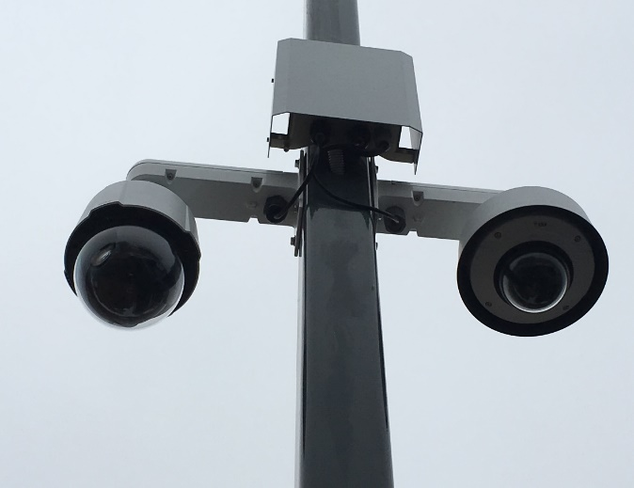
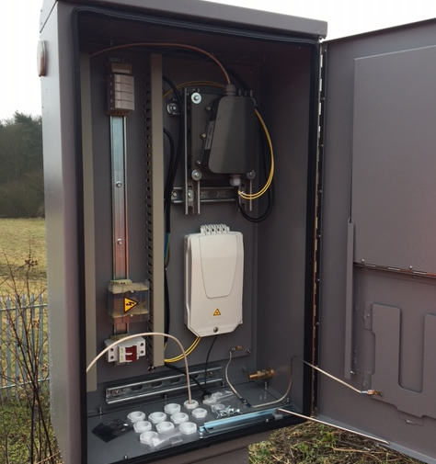
Real deployment pictures

Slide 26
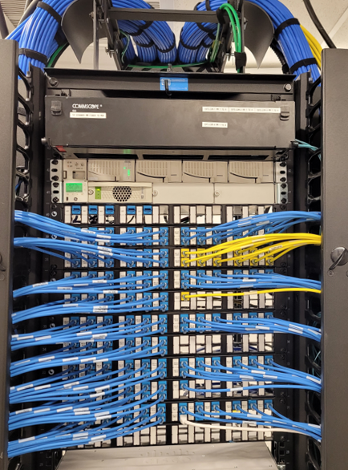
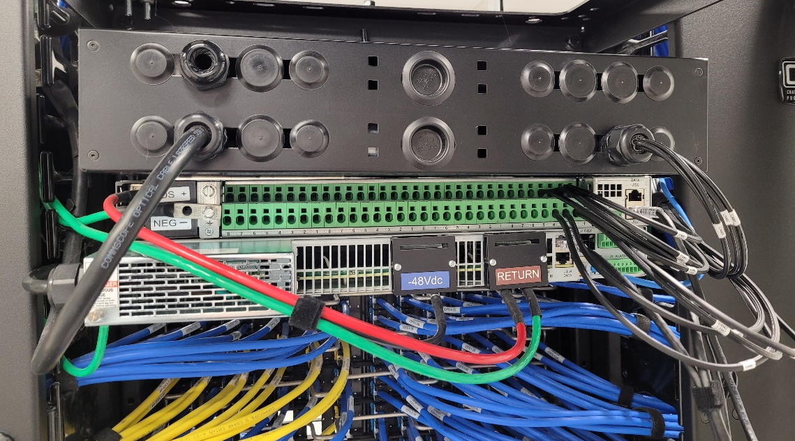
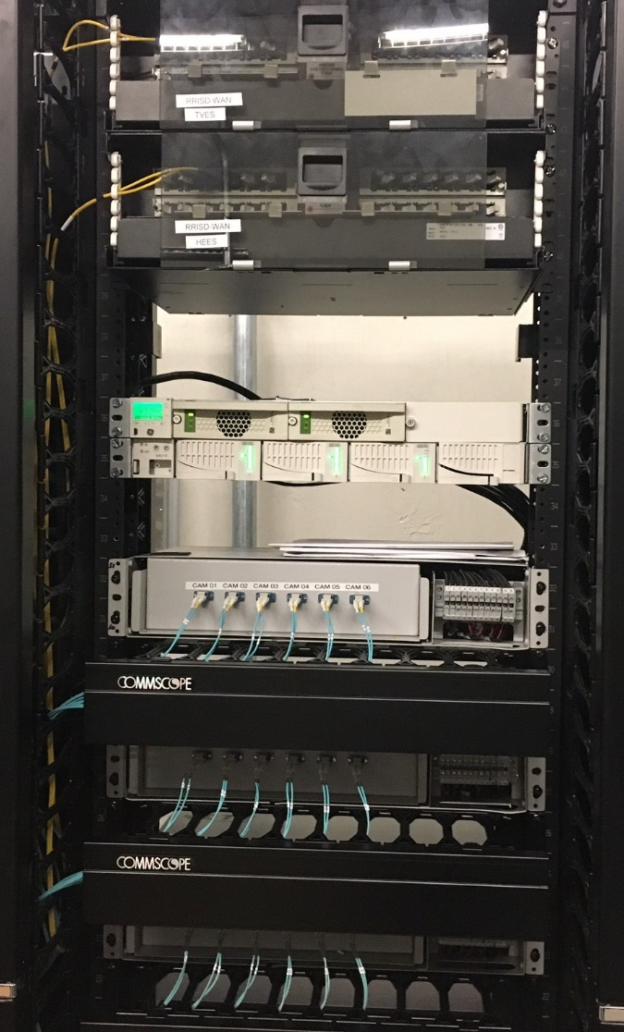
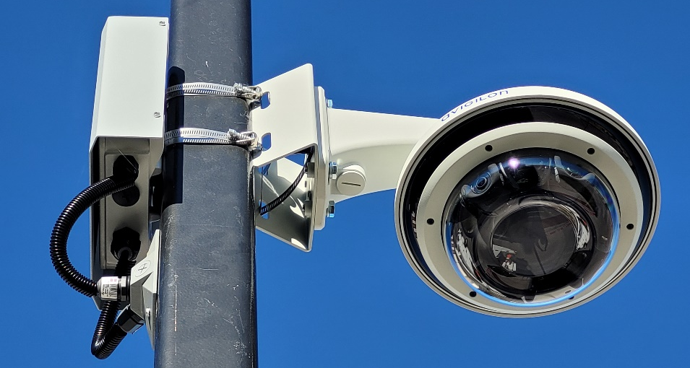
Real deployment pictures

